Slide 1
Exceptions in Java

Slide 2
Workflow
What is an Exception
Exceptions Hierarchy
Types of Exceptions
How to work with Exceptions
Custom Exceptions
Testing Exceptions in Junit Examples
Inheritance rules of Exception
Exceptions best practices
Additional Information

Slide 3
What is an Exception?
Exception is an event that disturbs the normal workflow of our application.
Exception is an object which is thrown at runtime.
It causes our program to terminate abnormally.

Slide 4
Example N1 Simple Exception Scenario

Slide 5
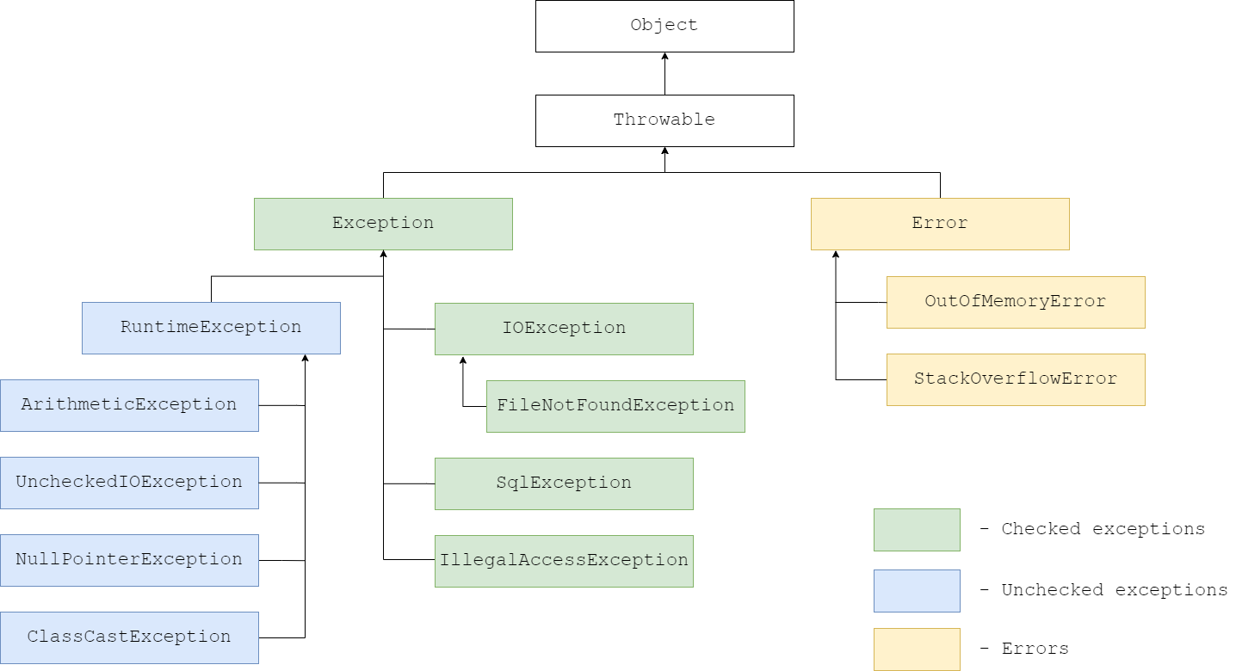
Exceptions Hierarchy

Slide 6
What is Throwable?
In Java, exceptions are objects. When you throw an exception, you throw an object. You cannot throw just any object as an exception, but only those whose class descends from throwable.
The Throwable Class is the superclass of all errors and exceptions in Java. Only objects that are instances of this class are thrown by the JVM, or can be thrown by the java throw statement.
Some essential methods of throwable are getMessage(), printStackTrace().

Slide 7
Example N2 getMessage(), printStackTrace()

Slide 8
Types of Exceptions
Checked Exceptions, also known as compiler time exceptions.
Unchecked Exceptions, also known as runtime exceptions.
Errors.

Slide 9
How to work with Exceptions
When working with Exceptions we use Try-catch Block.
In Try-catch block, we examine that our code might though an exception.
In Try block, we enclose the code which might though an exception.
In Catch block, we define a block of code to be executed if specific exception happens.
All blocks must be ordered from most specific to most general, meaning for example Arithmetic exception should come first before Exception.

Slide 10
Finally block
We can add finally statement to the Try-catch block.
Finally block defines the statement to run the code regardless of the result
However, there are cases when finally block might not get executed. For example if you execute System.exit() in try block.

Slide 11
Example N3 Try-catch-finally

Slide 12
Few important notes about Try-catch-finally
We cannot have empty try block without catch or finally related to it.
We can have try and finally block without catch block.
We cannot have catch or finally block without try block.
We can only have one try, one finally block, however we can have several catch blocks (In single try-catch-finally block).

Slide 13
Example N4 Different Scenarios with Try-catch

Slide 14
Custom Exceptions in Java
Custom exceptions provide us possibility to provide additional information, and be more specific about our exception, which is not provided by standard Java Exception.
For creating custom checked exception we extend Exception class, if we are creating custom unchecked exception we extend the RuntimeException class. If you are creating custom error extend the Error class.

Slide 15
Choose between Checked and Unchecked Exception
If exception is recoverable from, and it is more likely customer side error rather than system then we should choose a checked exception.
If exception is unrecoverable, and more likely a system error rather than customer one, then we should choose an unchecked exception.
If there is a serious problem in the system, like shortage of system resources then it is considered to be an error rather than exception. Imagine having memory leak in your program, using a resource which causes memory problems.

Slide 16
Example N5 Creating Custom Exceptions

Slide 17
Difference between Throw and Throws
Throw keyword is used to throw exception explicitly, in the code, inside function or block of code.
Throws keyword is used in the method signature to declare an exception which might be thrown by the function, while executing the code.
Note Throws keyword must be used with Checked Exceptions. You cannot declare Checked exception without Throws keyword.

Slide 18
Example N6 Exception Testing in Junit

Slide 19
Inheritance rules of exception
If SuperClass does not declare an exception, then the SubClass can only declare unchecked exceptions, but not the checked exceptions.
If SuperClass declares an exception, then the SubClass can only declare the same or child exceptions of the exception declared by the SuperClass and any new Runtime Exceptions, just not any new checked exceptions at the higher level.
If SuperClass declares an exception, then the SubClass can declare without exception.

Slide 20
Best Practices With Exception Handling
Always try to catch particular subclasses, instead of catching just general Exception class.
Do not have empty catch blocks, because you are swallowing exception in that case. Error swallowing (or error hiding), is a bad practice. Swallowing exception means when we catch an exception and continue to work without logging, processing or reporting the error.
Always catch only those exceptions that can be handled.

Slide 21
Try-With-Resources
Try-with-resources was introduced in java 7 which allows us to declare resources to be used in a try block with the assurance that the resource will be closed after that execution. So we should not worry if the developer forgot to close the resources, which might have caused memory leaks, and OutOfMemoryError.
To make out object eligible for try with resources, our object should implement either Closable, or AutoClosable interface, which has one method close().

Slide 22
Example N7 Try-with-resources

Slide 23
Example N8 NullPointerException

Slide 24
What is a suppressed exception?
In simple words suppressed exception is an exception that is thrown but somehow ignored.
A simple scenario for this is when the finally block throws an exception, any exception originally thrown in the try block then is suppressed.

Slide 25
Example N9 Suppressed Exception

Slide 26
Why use try-catch block instead of if-else?
Try-catch block is considered the recommended approach for error handling, however you can do the same logic with if-else.
Try-catch is a better approach in error handling, because we are not dependent on our prediction. In if-else we are predicting that error will happen.
Try-catch is more readable and maintainable compared with if-else in error handling.
Also Throwable has a lot of useful methods to work with exceptions like printStackTrace(), getMessage(), addSuppressed(Throwable t) and etc.

Slide 27
Example N10 StackOverflowError

Slide 28
Thanks for listening!

